Slide 1
RUNGTA COLLEGE OF DENTAL SCIENCES & RESEARCH
TITLE OF THE TOPIC-
THEORIES OF GROWTH
DEPARTMENT OF ORTHODONTICS AND DENTOFACIAL ORTHOPAEDICS

Slide 2
Specific learning Objectives
CORE AREAS | DOMAIN | CATEGORY
INTRODUCTION | AFFECTIVE | DESIRE TO KNOW
GROWTH DEFINITIONS | COGNITIVE | NEED TO KNOW
MAJOR THEORIES OF GROWTH | COGNITIVE | MUST KNOW
FMH IN DETAIL | COGNITIVE | MUST KNOW

Slide 3
CONTENTS :
PART I
Introduction
Growth: Some definitions
Major theories of growth
Bone remodeling theory
The genetic theory
The sutural hypothesis
Nasal septum theory
PART II
Functional matrix hypothesis In detail
Growth relativity hypothesis
Conclusion
References

Slide 4
Introduction :
It is truism that growth is strongly influenced by genetic factors, but it also can be significantly affected by the environment in the form of nutritional status. Degree of physical activity, health or illness, and a number of similar factors.
Since a major part of the need for orthodontic treatment is created by disproportionate growth of the jaws, in order to understand the etiologic processes of malocclusion and dentofacial deformity, it is necessary to learn how facial growth is influenced and controlled.

Slide 5
Growth: Some Definitions
Todd
An increase in size
Krogman
Increase in size, change in proportion and progressive complexity
Moss
Change in any morphological parameter which is measureable
Stewart
It is a process that leads to increase in the physical size of cells, tissues, organs, or organisms as a whole.

Slide 6
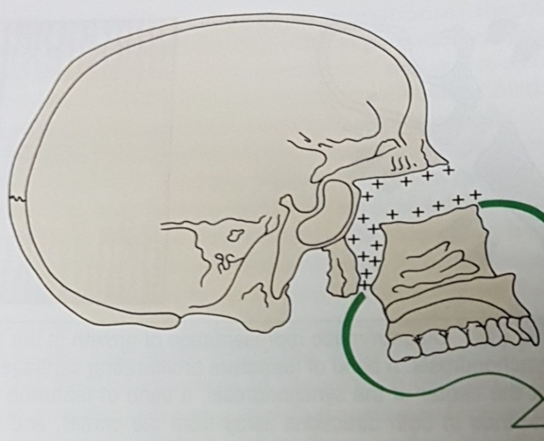
Remodelling Theory of Craniofacial Growth (Brash 1930)
Principal tenets:
Bone only grows appositionally at surfaces
Growth of the jaws : by deposition at posterior surfaces of maxilla and mandible called as “Hunterian” growth of the jaws.
Notes:
It postulated that craniofacial skeletal growth takes place by bone remodeling-selective deposition and resorption of bone at its surface.

Slide 7
Calvarial growth: deposition of bone on the ectocranial surface of the cranial vault and resorption of bone endocranially.
Cranial vault as a model

Slide 8
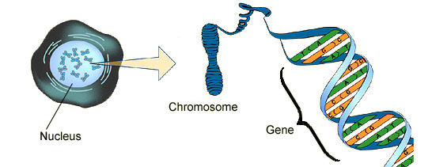
Genetic theory (Brodie 1941) :
This theory simply states that genes determine and control the whole process of craniofacial growth.
Genetic concept suggests that the genes supply al the information in growth and development.
This originated with classical Mendelian genetics.
Notes:
Simply involve the statistical approach of mendel but failed to give reasons.

Slide 9
But it failed in understanding the mechanism by which the traits are transmitted at that time.
It did not take into account the effects of environment in growth.
Later with the blending of data from vertebral paleontology created the Neo-Darwinism synthesis which is currently accepted paradigm of phylogenetic regulation.

Slide 10
Genetic concepts stipulate that the genotype supplies all the information required for phenotypic expression.
Mossalso stated in his thesis that the whole plan of growth, the various operations carried out, the order and site of growth and their co-ordination with other system are all embossed in the nucleic acid message.
The field of genetics consists of two principle areas:
“TRANSMISSION GENETICS” is characterized by statistical approach and involved only in explaining possible method of transmission.
It is based on Mendelian laws and didn’t explain about genes or its characteristics.

Slide 11
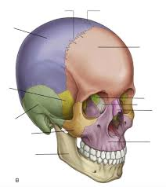
The Sutural Theory (Sicher and Weinnman 1952)
Acc. to this theory, sutures, cartilage and periosteum are all responsible for facial growth.
Sutures are the main contributor of growth in craniofacial region.
The craniofacial skeleton enlarges due to the expansible forces exerted by the sutures as they separate(next fig.)
Notes:
It mainly states that pressure axerted by growing sutures onto the adjacent bone cause bone growth

Slide 13
…
Growth of midface takes place via intrinsically determined sutural expansion of the circummaxillary suture system.
Mandibular growth by growth of cartilage of mandibular condyle.

Slide 14
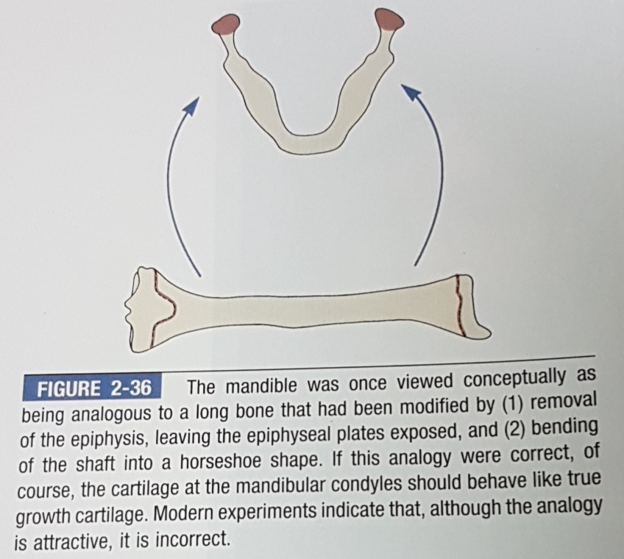
Sicher perceived the mandible as a long bone and the condylar cartilage as comparable to epiphyseal plate.

Slide 15
The sutural theory reinforced the concept that growth of the face and jaws was essentially immutable and independent
Sicher and Weinnman considered suture as a three layered structure.
There is spreading of suture due to proliferation of middle layer of the sutural tissue.

Slide 16
Acc. to this concept, tissue separating force exist in the suture itself.
But it is now clear from histological evidences that sutural tissue is not identical to epiphyseal plate of bones.

Slide 17
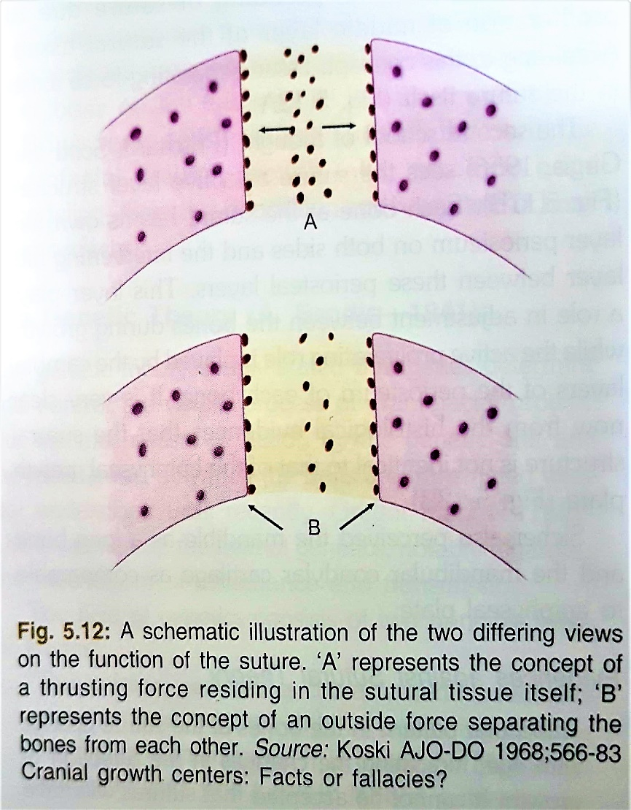
Notes:
3 layer structure : connective tissue b/w 2 bones play the same role as cartilage at the base of skull
5 layer structure : each bone at the suture has its own 2 layer periosteum on both sides & intervening 5th layer inbetween.

Slide 18
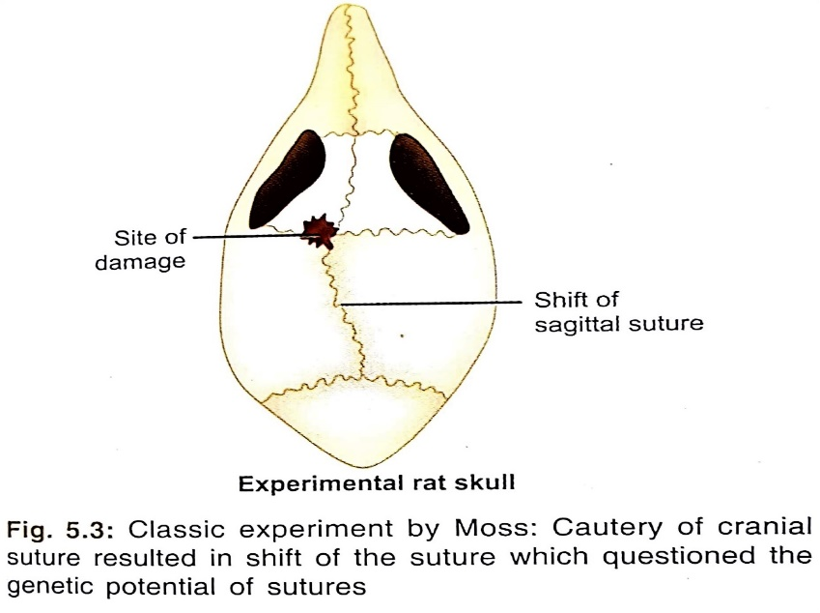
Points against Sutural Theory
Changing of trabecular pattern with age indicate change in direction of growth. It is not acceptable that sutures will have the necessary information for altering growth.
Extirpation of facial sutures have no appreciable effect on facial skeletal growth thus no innate growth potential.
Shape of suture is dependent on functional stimuli

Slide 19
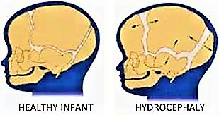
Sutural growth can be halted by mechanical force
Subcutaneous auto transplantation of the zygomatic-maxillary suture in the Guinea pigs have not been found to grow.
Growth takes place in cases of untreated cleft palate
Couldn't explain hydrocephaly and microcephaly

Slide 20
Cartilaginous Theory (Scott)
Also known as Scott hypothesis / Nasal septum theory / Nasocapsular theory.
Essence of theory:
According to this theory, sutures play little role or no direct role in the growth of the craniofacial skeleton .
Sutures are considered as merely passive, secondary and compensatory sites of bone formation and growth
Intrinsic growth controlling factors were present only in cartilage and periosteum
Notes:
Intrinsic growth controlling factors were present only in cartilage and periosteum and not in the sutures as described by sicher

Slide 21
Growth in sutures was permissive, secondary and entirely dependent on the growth of the cartilage and adjacent soft tissues.
The cranial base synchondroses cause the growth of the cranial base and Scott compared the condylar cartilage to the cranial base cartilage.
Histologic research validates much of the Scott hypothesis
Nasal septum is most active and important part for craniofacial skeletal growth at late prenatally and early postnatally

Slide 22
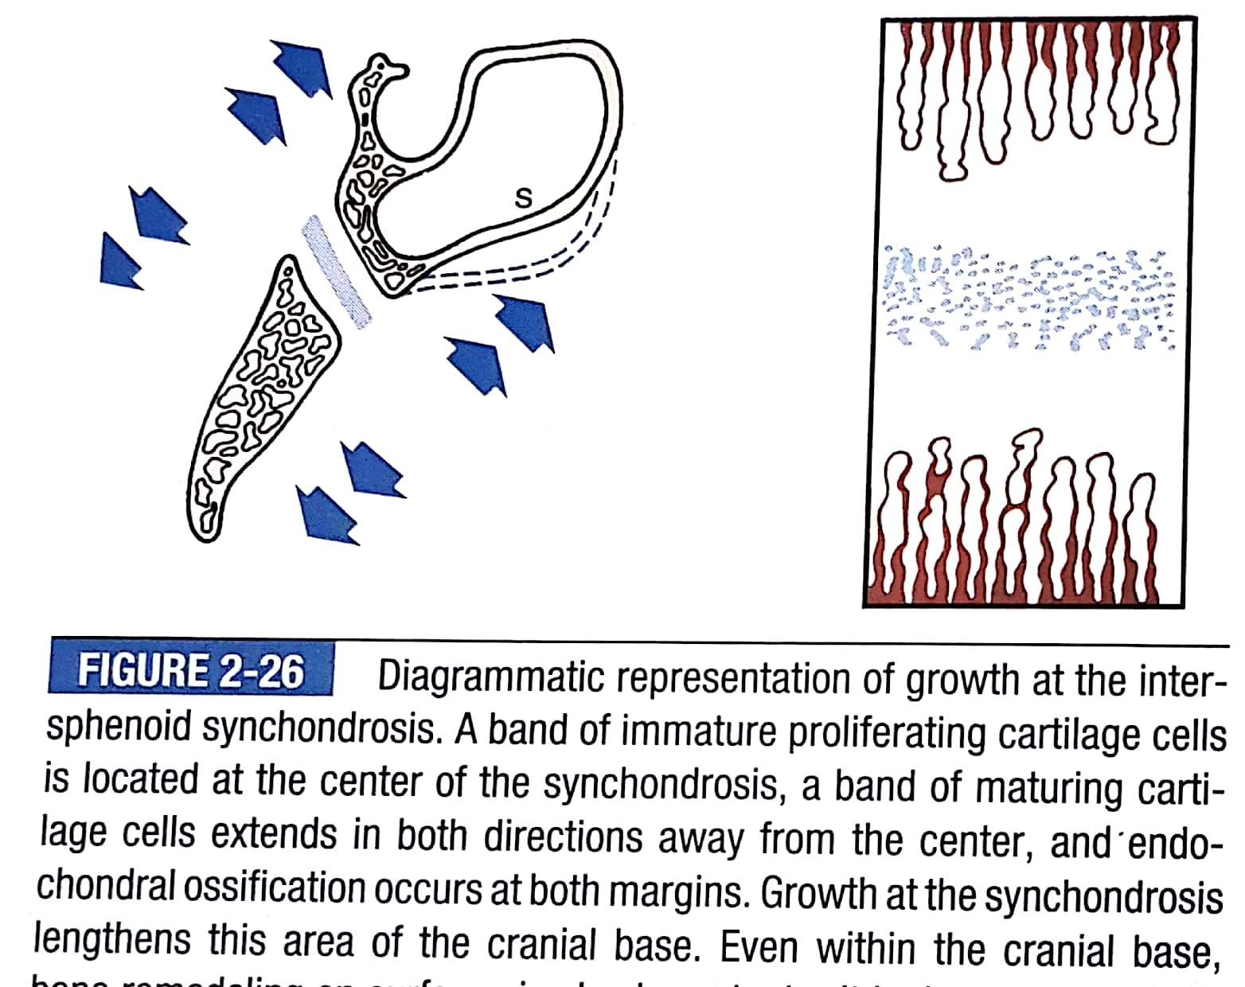
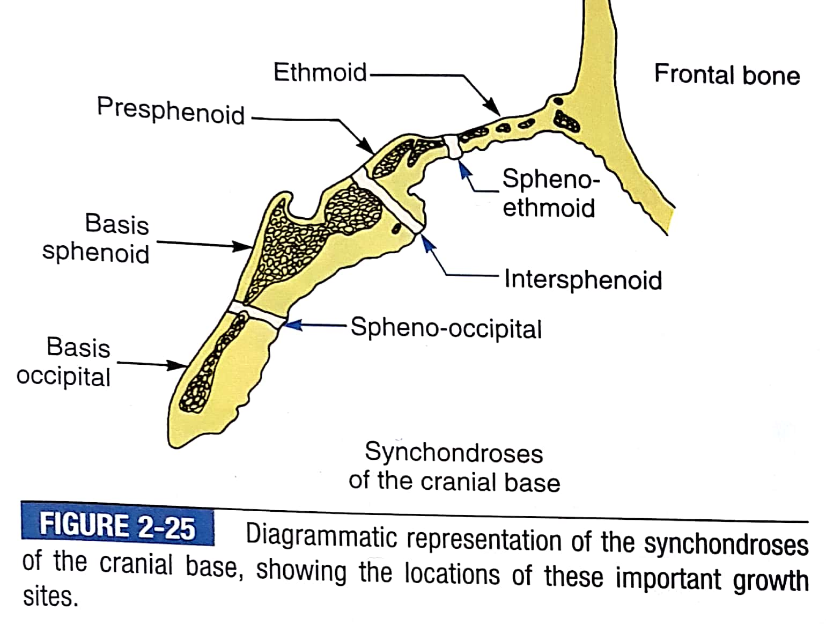

Slide 23
The anterior-inferior growth of the nasal septal cartilage, buttressed against the cranial base posteriorly, “drives” the midface downward and forward
Cartilage of the mandibular condyles directly determines the growth of the mandible as its “pushes” the mandible downward and forward.

Slide 24
Growth of nasal septal(NS) cartilage pushes the midface downward and forward relative to anterior cranial base. This separates the midfacial suture system, which then fills in via secondary, compensatory sutural bone growth.

Slide 26
Evidences supporting the theory:
Extirpation of septal cartilage in growing rats resulted in deficient growth of the snout.
Burstone emphasized the importance of the septal growth impulse to maxillary growth in cleft palate cases.
Failures of the underdeveloped maxillary segment to unite with nasal septum in complete unilateral clefts deprives it of the growth impulse or energy. The normal contralateral side on the other hand, attained normal growth.

Slide 27
Evidence against the theory
Moss and Bloomberg(1968), Brigit Thilander (1970) found only slight deformity after extirpation of septal cartilage.
They concluded that septal cartilage provides only mechanical support for the nasal bones and is not a primary growth center.
Moss stated that malformation in snout following excision of nasal septum is due to trauma following surgery.
Therefore Scott’s hypothesis does not hold true completely

Slide 28
Conclusion :
At present ,nasal septum theory is still accepted as a reasonable explanation for craniofacial growth.
Nasal septum may be important for anteroposterior growth of face because of endochondral growth process occurring at its posterior border.
It is not considered to be an active contributor for vertical development of face.

Slide 29
TRANSMISSION OF FUNCTIONAL STIMULUS TO THE BONE - NEUROTROPHISM
Most important aspect of FMH is the mechanism by which the functional response or stimulus is converted or translated to the skeletal interface and the way they are regulated or controlled.
Neurotrophism is a non impulsive transmittive neurofunction involving axoplasmic transport providing for long term interaction between neurons and innervated tissue, which homeostatically regulate the morphological, compositional and functional integrity of those tissues.

Slide 30
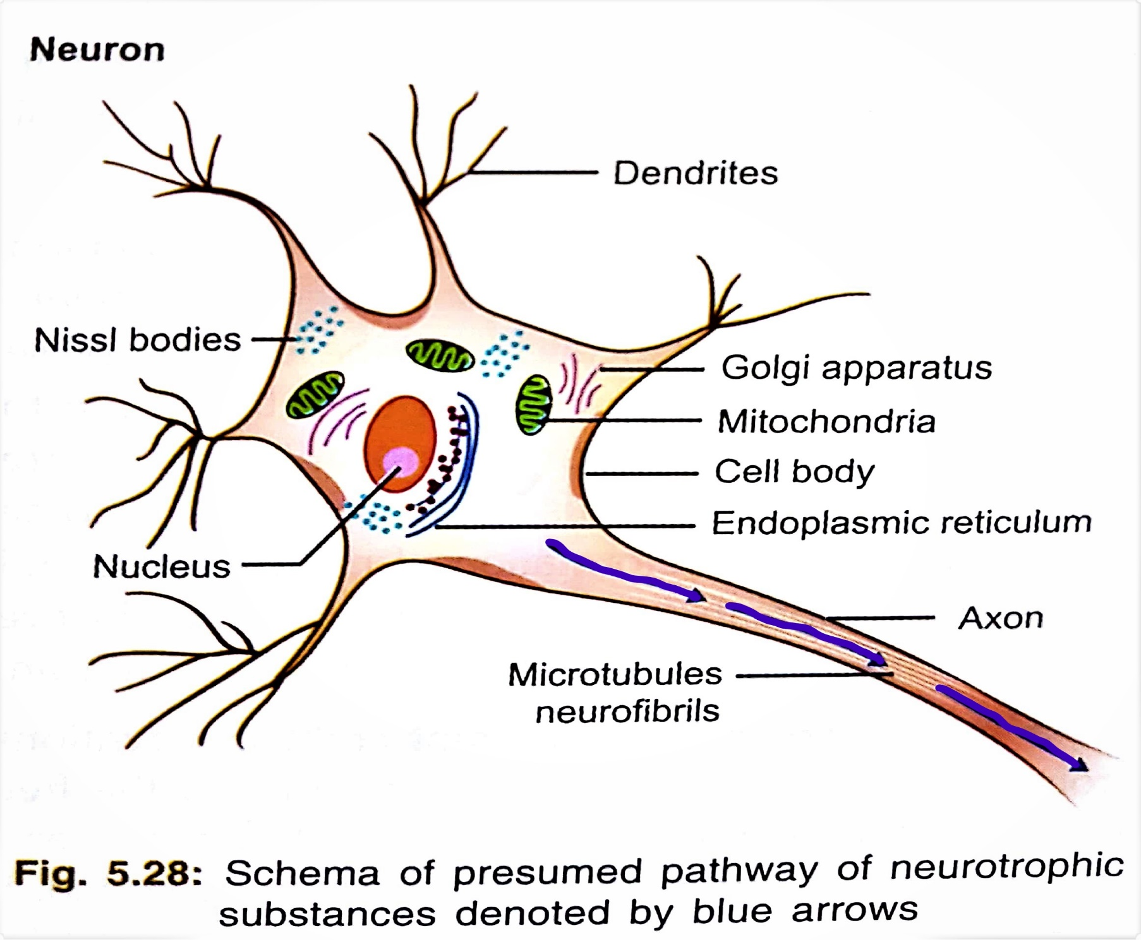

Slide 31
Types of Neurotrophism:
Moss classified Neurotrophism into three types arbitrarily :
NEUROTROPHISM
NEUROMUSCULAR
NEUROEPITHELIAL
NEUROVISCERAL

Slide 32
Neuromuscular trophism:
Neural innervations are established at myoblast stage.
The genetic control cannot reside solely in the functional matrices alone and there is neurotropically regulated homeostatic control of genome and similar neurotrophic mechanism exists for capsular matrix which passively regulate the functional cranial component.

Slide 33
Muscle denervation-reinnervation:
Muscle denervation and subsequent reinnervation enable us to differentiate effect on muscle tissue associated with loss of impulse conduction and muscle contraction from those due to loss of neurotrophic factors.
If motor neurons are sectioned and the muscle subsequently becomes reinnervated, there is reformation of muscle tissue and it grows even before the recovery of neuronal conductive function. This demonstrates neuromuscular trophism.

Slide 34
Neurovisceral trophism :
Increase and decease of mature salivary glands is under neurotrophic influence.
Neuroepithelial trophism :
The neurological work of neurotrophism first began in field of dermatology.
The factors which contribute to neuroepithelial trophism are
Local mechanism operating in areas of high mitotic activity
Epithelial growth factors.
Presence of taste buds is dependent upon intact neural innervation

Slide 35
Neurotrophic control of genetic activity:
Neurotrophic control of genetic activity is demonstrated in many tissues under experimental conditions:
Protein synthesis in oral epithelial cells and specific enzymatic synthesis in taste buds epithelium appear to be neurotrophically regulated.
It is suggested that the regenerating nerve exert a direct control on the synthesis of DNA, RNS and protein in regenerating tissue.

Slide 36
Conclusion For Theories Of Growth :
A good knowledge of growth and development helps us to know the etiology, diagnosis and treatment planning of malocclusion and also helps us to predict the prognosis of orthodontic treatment.
Growth modification by means of functional and orthodontic appliance gives better response before growth completion (best results during growth spurts).
Orthognathic surgery gives best results if done after completion of growth so as to prevent relapse.

Slide 37
SUMMARY
GROWTH :-
Major theories of growth
Bone remodeling theory
The genetic theory
The sutural hypothesis
Nasal septum theory
Functional matrix hypothesis
Von Limborgh’s compromise theory
Modern composite theory
Servo system theory/cybernetics in craniofacial growth
Growth relativity hypothesis
Functional matrix hypothesis revisited

Slide 38
REFERENCES
Textbook of Orthodontics – Gurkeerat Singh, Jaypee Brothers; 2nd Edition
Orthodontics – The Art and Science, S.I Bhalajhi, AryaMedi Publishing; 7th Edition
Textbook of Orthodontics – Sridhar Premkumar, Elsevier; 1st Edition
Orthodontics: Diagnosis and Management of Malocclusion and Dentofacial Deformities – O.P Kharbanda, Elsevier; 1st Edition

Slide 39
Question & Answer Session

